Slide 1
Macroeconomics ECON 101
GDP: Measuring Total Production and Income
(Chapter 4)
Instructor: Muhebullah Karimzada
Notes:
If this PowerPoint presentation contains mathematical equations, you may need to check that your computer has the following installed:
1) MathType Plugin
2) Math Player (free versions available)
3) NVDA Reader (free versions available)

Slide 2
Chapter Outline
4.1 Gross Domestic Product Measures Total Production
4.2 Does GDP Measure What We Want It to Measure?
4.3 Real GDP versus Nominal GDP
4.4 Other Measures of Total Production and Total Income

Slide 3
Some Important Terms in Macroeconomics
Business cycle: Alternating periods of economic expansion and economic recession.
Expansion: The period of a business cycle during which the total production and total employment are increasing.
Recession: The period of a business cycle during which total production and total employment are decreasing.
Economic growth: The ability of an economy to produce increasing quantities of goods and services.
Inflation rate: The percentage increase in the price level from one year to the next.

Slide 4
Gross Domestic Product Measures Total Production
4.1 Learning Objective
Explain how total production is measured.
The most common measure used by economists of overall economic activity in an economy is gross domestic product, or GDP.
Gross domestic product (GDP): The market value of all final goods and services produced in a country during a period of time, typically one year.
We will examine each of the parts of this definition in turn.

Slide 5
“Market Value”
Gross domestic product: The market value of all final goods and services produced in a country during a period of time, typically one year.
We cannot add together the number of cars, melons, haircuts, and all other goods and services—the result would be meaningless.
Before we can add things up we need a common unit.
The most practical way to get a common unit is to value each good and service in monetary (dollar) terms.
The best measure of value that we have is the price that each good or service is sold for.

Slide 6
Final Goods and Services (1 of 2)
Gross domestic product: The market value of all final goods and services produced in a country during a period of time, typically one year.
A final good or service is a good or service purchased by a final user. These are what are used to calculate GDP.
Why? Intermediate goods and services are inputs into another good or service, such as a tire on a truck. If we counted these goods and services at each transaction, we would end up double counting.
Example: If we counted the value of the ice cream bought by a store, and also counted the value of that ice cream when it was sold to a consumer, we would be double counting the value of the ice cream.

Slide 7
Final Goods and Services (2 of 2)
Gross domestic product: The market value of all final goods and services produced in a country during a period of time, typically one year.
GDP measures output produced within a country’s borders. The ownership of that production is irrelevant, e.g. production by a Canadian firm or a foreign firm counts equally, as long as the production takes place in Canada.
However, production overseas does not count, even if it is performed by a Canadian firm.

Slide 8
“During a Period of Time”
Gross domestic product: The market value of all final goods and services produced in a country during a period of time, typically one year.
To measure total output in a given year, we measure the goods and services produced only in that given year.
Again, this avoids double-counting: if you buy a textbook in 2022, that textbook counts in 2022’s GDP. If you resell it in 2023, it will not count again in 2023’s GDP.
So GDP counts only new goods and services. Used items were previously produced and counted, so don’t need to be counted again.

Slide 9
Production and Income
There are two main conceptual ways to measure the total economic activity in an economy: total production or total income.
When we measure one, we are also measuring the other.
Why?
Everything that is produced and sold constitutes income for someone.
We have the choice of measuring economic activity using the value of products produced and sold, or the value of incomes.

Slide 10
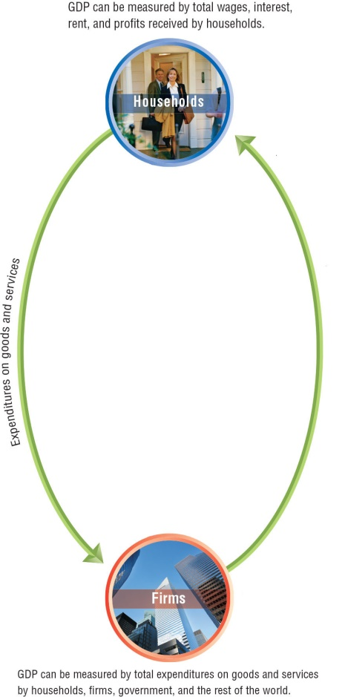
Figure 4.1 The Circular Flow and the Measurement of GDP (1 of 4)
In a very simple model of the economy, we could start with households and firms.
To measure overall economic activity, we could measure the amount of money that households spend on goods and services.
Or we could measure incomes of households.
Notes:
The circular-flow diagram illustrates the flow of spending and money in the economy. Firms sell goods and services to three groups: domestic households, foreign firms and households, and the government. To produce goods and services, firms use factors of production: labor, capital, natural resources, and entrepreneurship. Households supply the factors of production to firms in exchange for income in the form of wages, interest, profit, and rent. Firms make payments of wages and interest to households in exchange for hiring workers and other factors of production. The sum of wages, interest, rent, and profit is total income in the economy. We can measure GDP as the total income received by households. The diagram also shows that households use their income to purchase goods and services, pay taxes, and for savings. Firms and the government borrow the funds that flow from households into the financial system. We can measure GDP either by calculating the total value of expenditures on final goods and services or by calculating the value of total income.
Long Description:
An arrow from household pointing to firm reads expenditures on goods and services, and another arrow from firms point to households. Above the households, the flowchart reads GDP can be measured by total wages, interest, rent, and profits received by households. Below the firms, the flowchart reads GDP can be measured by total expenditures on goods and services by households, firms, government, and the rest of the world.

Slide 11
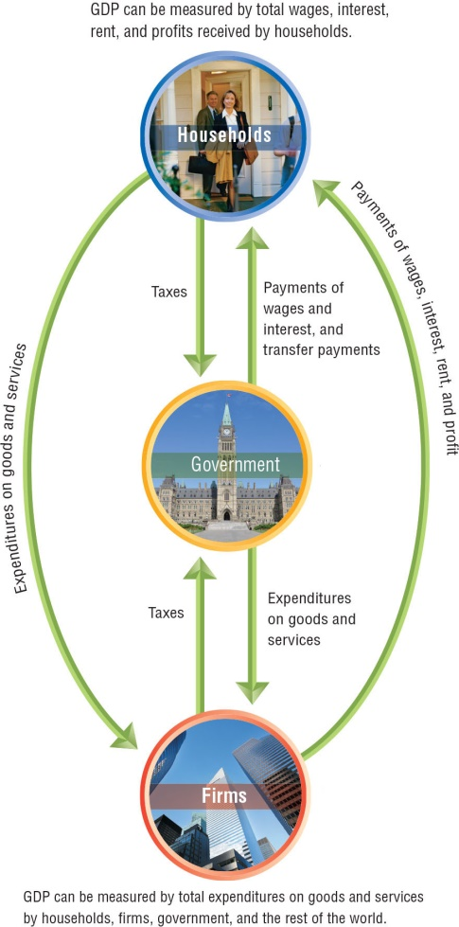
Figure 4.1 The Circular Flow and the Measurement of GDP (2 of 4)
Let’s add in some more layers. We’ll start with government.
How does the government affect economic activity?
It takes in taxes from households and firms.
It uses those taxes to buy goods and services, and to make transfer payments.
Notes:
Long Description:
Arrows labeled taxes point from households, and firms to government. An arrow from government points to households and labeled payments of wages and interest, and transfer payments. Another arrow from government points to firms and is labeled expenditures on goods and services. An arrow from household pointing to firm reads expenditures on goods and services, and another arrow from firms point to households and is labeled payments of wages, interest, rent, and profit. Above the households, the flowchart reads GDP can be measured by total wages, interest, rent, and profits received by households. Below the firms, the flowchart reads GDP can be measured by total expenditures on goods and services by households, firms, government, and the rest of the world.

Slide 12
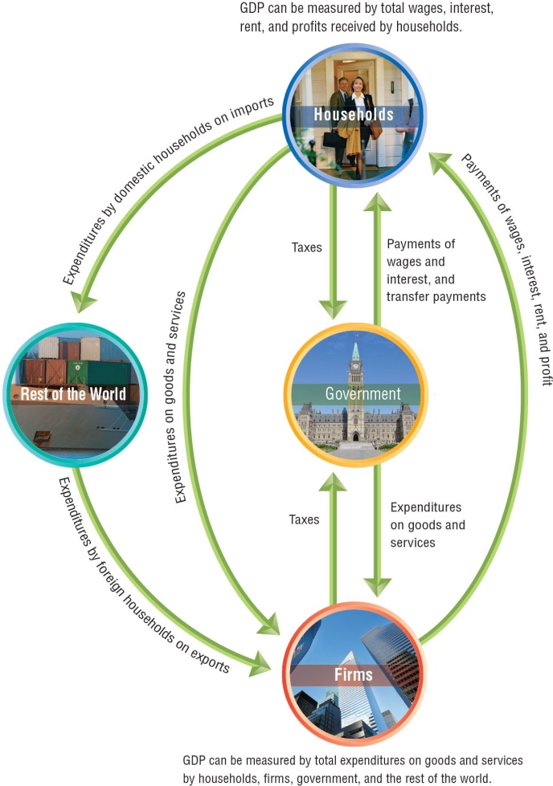
Figure 4.1 The Circular Flow and the Measurement of GDP (3 of 4)
Some economic activity takes place between households, firms, and the rest of the world.
Households buy goods and services from firms in other countries; these are known as imports.
Firms sell goods and services to households in other countries; these are known as exports.
Notes:
Long description:
Arrows that read “Taxes” point from households, and firms to government. An arrow from government points to households and reads “Payments of wages and interest, and transfer payments.” Another arrow from government points to firms and reads “Expenditures on goods and services.” An arrow from household pointing to firm reads “Expenditures on goods and services, and another arrow from firms point to households and reads “Payments of wages, interest, rent, and profit.” Above the households, the flowchart reads “GDP can be measured by total wages, interest, rent, and profits received by households.” Below the firms, the flowchart reads “GDP can be measured by total expenditures on goods and services by households, firms, government, and the rest of the world.” An arrow from households pointing to rest of the world reads “Expenditures by domestic households on imports,” and an arrow from rest of the world pointing to firms reads “Expenditure by foreign households on exports.”

Slide 13
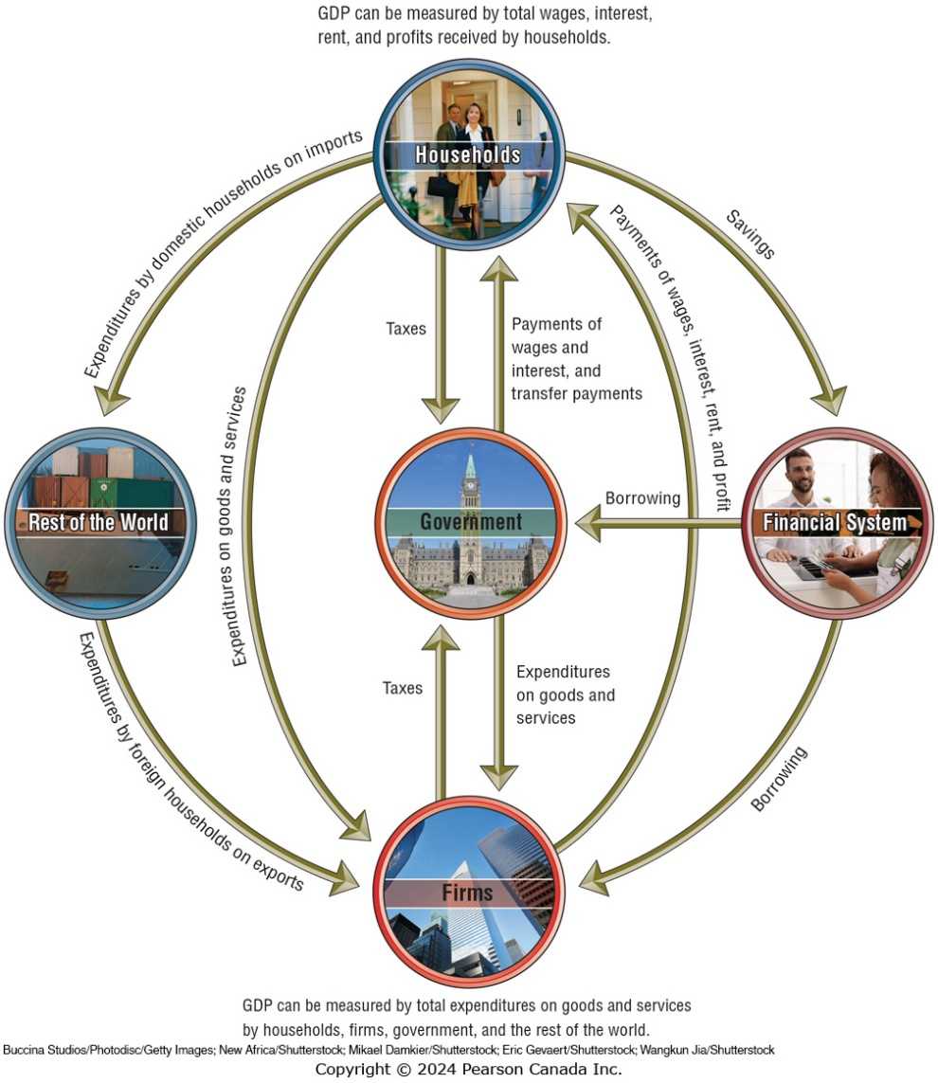
Figure 4.1 The Circular Flow and the Measurement of GDP (4 of 4)
Finally, there are firms that deal specifically in flows of money; we label these firms as financial system.
Households choose not to spend some of their income, and instead save it with financial system firms like banks.
These financial system firms lend money to other firms and the government.

Slide 14
Income Approach to Measuring GDP
To measure GDP Statistics Canada keeps track of incomes.
The Income Approach has 5 Components
Compensation of Employees
Gross Operating Surplus
Gross Mixed Income
Taxes less Subsidies
Statistical Discrepancy
We will examine each component of the Income Approach to measuring GDP in turn.

Slide 15
Compensation of Employees
Compensation of Employees covers all the benefits workers receive from providing their labour to firms.
This makes up the single largest element of GDP in the income approach at 50 percent of GDP.
There are two components to compensation of employees
Wages and Salaries: money paid to workers.
44% of GDP in 2021
Employers’ Social Contributions: payments made by employers to social programs on behalf of employees.
7% of GDP in 2021

Slide 16
Gross Operating Surplus
Gross Operating Surplus covers payments to owners of the capital used by firms and government.
Gross Operating Surplus accounted for 27.7% of GDP in 2021
Two elements to Gross Operating Surplus
Net Operating Surplus: payments to owners of capital over and above compensation for capital that wore out.
14.2% of GDP in 2021
Capital Consumption: payments to the owners for capital that wore out.
13.4% of GDP in 2021

Slide 17
Gross Mixed Income
Gross Mixed Income: covers income generated by small businesses for their owners.
Gross mixed income accounted for 11.9% of GDP.
Statistics Canada breaks gross mixed income down into
Consumption of Fixed Capital: the depreciation of the capital used by small businesses.
3.1% of GDP
Net Mixed Income: the payment to owners of small businesses over and above the compensation for depreciation of capital owned by the business.
8.7% of GDP

Slide 18
Taxes Less Subsidies
Taxes Less Subsidies: payment to government that mimics income received by the owners of other inputs.
Taxes Less Subsidies accounted for 9.4% of GDP

Slide 19
Expenditure Approach to Measuring GDP
To measure GDP Statistics Canada keeps track of spending.
The Expenditure Approach has 5 Components
Final Consumption
Gross Fixed Capital Formation
Investment in Inventories
Net Exports of Goods and Services
Statistical Discrepancy
We will examine each component of the Expenditure Approach to measuring GDP in turn.

Slide 20
Final Consumption
Final Consumption: all domestic purchases of goods and services by their final users. Goods that will be used to satisfy needs and wants.
Purchases of clothing, paper by government, and food by food banks is all included in this category.
77% of GDP
Statistics Canada breaks final consumption down into three elements based on who does the spending.
Households: 54.1% of GDP
Government: 21.4% of GDP
Not for Profit Organizations: 1.5% of GDP

Slide 21
Gross Fixed Capital Formation
Gross Fixed Capital Formation: is the purchase of fixed assets (capital) by firms, governments, and households. Fixed assets are goods that will provide benefits over a long period of time and cannot easily be converted into cash.
Examples: Buildings, Machinery
23.2% of GDP
Broken down by who buys the fixed asset.
Business 19.1% of GDP
Government 4% of GDP

Slide 22
Investment in Inventories
Investment in Inventories: spending on finished products kept on hand to sell.
In 2021, inventory investment was -$13,368.

Slide 23
Net Exports
Net Exports: value of exports minus the value of imports.
Exports are goods and services produced in Canada and sold to foreign firms, governments, and households.
Imports are goods and services produced in other countries and bought by Canadian firms, governments, and households.
Net exports: 2.8% of GDP in 2021
The negative means that we imported more than we exported.
Exports 30.8% of GDP in 2021
Imports 30.6% of GDP in 2021

Slide 24
Statistical Discrepancy
Statistical Discrepancy: an accounting item that ensures that the income and expenditure approach yield the same result.
Small errors in original data and differences in estimation techniques mean the income and expenditure approaches will give slightly different values for GDP.
Statistics Canada takes the difference between the two approaches, divides it in half, and adds one half to the lower of the two estimates and subtracts the other half from the greater of the two estimates.
The statistical discrepancy is just 0.0004% of GDP.

Slide 25
The Expenditure Approach in Macro Models
The models in the rest of the text are built around an older version of the expenditure approach to measuring GDP. In this approach, spending is divided up based on who does the spending rather than the purpose of spending.
This method of adding up spending gives us the model:
Y = C + I + G + NX
Consumption (C): final consumption expenditure by households.
Investment (I): money spent by firms on fixed capital formation and inventories.
Government spending (G): Fixed capital formation and final consumption done by government.
Net Export (NX): exports minus imports
Notes:
Y = C + I + G + Nx should be familiar to students by the end of the course.

Slide 26
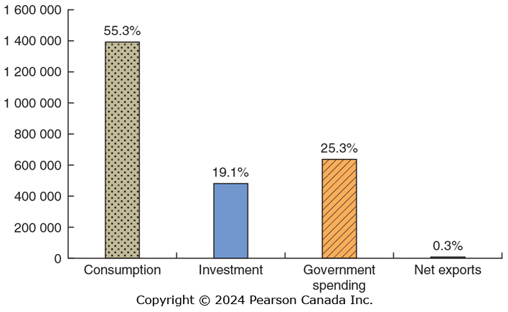
Components of GDP
Consumption is the largest component of GDP; within that, services are the largest component—almost half of GDP.
In recent years, net exports have typically been negative, which reduces GDP.
SOURCE: Statistics Canada. Table 36-10-0104-01 Gross domestic product, expenditure-based, Canada, quarterly (×1,000,000), https://www150.statcan.gc.ca/t1/tbl1/en/tv.action?pid=3610010401.

Slide 27
Table 4.1 Calculating Value Added
An alternative method to measure GDP is to measure the value added: the market value a firm adds to a product.
The final selling price of a product must equal the sum of the values added to the product at each stage of production.
The table below illustrates this method for a diamond from the Diavik mine in the NWT.
Firm | Value of Product | Value Added
Diavik Diamond Mine | Value of raw diamond = $500 | Value added by diamond miner | = $500
Gem cutter | Value of cut diamond = $700 | Value added by diamond cutter = ($700 - $500) | = $200
Jewellery designer | Value of set diamond = $1000 | Value added by jewellery designer = ($1000 - $700) | = $300
Jewellery store | Value of diamond rin = $1500 | Value added by jewellery store = ($1500 - $1000) | = $500
 | Total Value Added |  | = $1500

Slide 28
Does GDP Measure What We Want It to Measure?
4.2 Learning Objective
Discuss whether GDP is a good measure of well-being.
GDP can be a useful tool to measure total output in an economy. Many people go further than this, interpreting GDP as a measure of the well-being of citizens.
However, GDP has shortcomings as both a
Measure of total production and a
Measure of well-being.

Slide 29
Shortcomings of GDP as a Measure of Total Production
Two important types of production are omitted from Statistics Canada’s measurement of GDP:
Household Production
Household production such as childcare, cleaning, and cooking is not typically paid for with money. However such contributions are real—if they were performed by a non-household-member, they would be paid for and counted in GDP.
The Informal Economy
Buying and selling of goods and services might be concealed from the government to avoid taxes or regulations or because the goods and services are illegal. This constitutes the informal economy.
It is estimated that the Canadian shadow economy is 13 percent of the size of the officially measured GDP, and it is substantially larger in low-income countries.

Slide 30
How Important are these Shortcomings?
If we are comparing GDP from year to year, the size of household production and the informal economy is probably about the same from year to year, so GDP growth is a reasonable measure of the growth in total production.
However over long periods of time, these shortcomings might be more serious.
Example: As women have entered the workforce in larger numbers, some household production has been replaced by paid childcare and restaurant meals. So increases in GDP may exaggerate the increase in actual total production.

Slide 31
Shortcomings of GDP as a Measure of Well-Being
GDP per capita (i.e. GDP divided by population) is often used to represent differences in standards of living from country to country. However, even if it accurately measures total production, it would not reflect:
The value of leisure
Pollution and other negative effects of production
Crime and other social problems
The distribution of income
To summarize, a person’s well-being depends on many factors that are not considered when calculating GDP.
Example: Lower crime would allow lower spending on police, prisons, and private security. This would decrease GDP, but surely result in improvements in economic well-being.

Slide 32
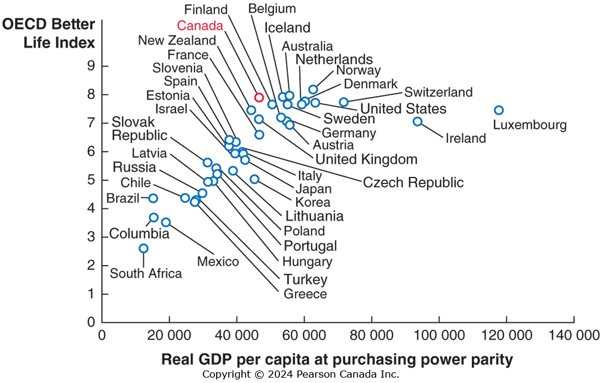
Social Explorer: GDP and Happiness
GDP isn’t meant to measure well-being, but well-being and GDP are related.
OECD constructed the “Better Life Index” meant to measure well being.
It turns out that higher GDP per person and a high Better Life Index often go together.
GDP isn’t a perfect measure of well-being, but it actually performs pretty well.
Well-being and Wealth
OECD Better Life Index (10 = best) and GDP per person, 2017
SOURCE: Data from Well-being and wealth: OECD Better Life index (10 = best) and GDP per person, 2017, The Organisation for Economic Co-operation and Development.
SOURCES: OECD Better Life Index, https://www.oecdbetterlifeindex.org/#/11111111111; OECD Aggregate National Accounts, SNA 2008 (or SNA1993): Gross Domestic Product, https://data.oecd.org/gdp/gross-domesticproduct-gdp.htm.

Slide 33
Real GDP versus Nominal GDP
4.3 Learning Objective
Discuss the difference between real GDP and nominal GDP.

Slide 34
Calculating Real GDP (1 of 2)
Since GDP is measured in “value” terms, we might have problems interpreting changes over time if prices change.
Is the increase in GDP due to increase in production, or due to increase in prices?
To separate these effects, Statistics Canada calculates both nominal GDP—the value of final goods and services evaluated at current-year prices—and real GDP—the value of final goods and services evaluated at base-year prices.
The choice of a base-year is arbitrary; we might use any year’s prices to compare real GDP in each year. The current standard is 2012.
The drawback of using base year is that relative prices also change from year to year, distorting real GDP calculations. Since 2003, Statistics Canada has used chain-weighted prices to reduce distortion, using previous-year prices to adjust current-year production measure.
Notes:
The details of calculating real GDP using chain-weighted prices are more complicated than we need to discuss here, but the basic idea is straightforward. Starting with the base year, take the average of prices in that year and prices in the following year. Then use this average to calculate real GDP in the year after the base year (2013 if the base year is 2012). For the next year—two years after the base year (2014)—calculate real GDP by taking an average of prices in that year and the previous year. In this way, prices in each year are “chained” to prices from the previous year, and the distortion from changes in relative prices is minimized.

Slide 35
Calculating Real GDP (2 of 2)
The table shows output and prices in 2012 and 2023.
Calculating the total value of output in 2023 using 2012 as base year gives:
$4000 + $880 + $1800 = $6680.
Most prices increased from 2012 to 2023 so using nominal GDP would have yielded a higher figure: $7800.
This highlights the need to use real GDP to avoid exaggerating growth.
Product | 2012 Quantity | 2012 Price | 2023 Quantity | 2023 Price
Energy drinks | 80 | $40 | 100 | $50
Pizzas | 90 | 11 | 80 | 10
Textbooks | 15 | 90 | 20 | 100
Product | 2023 Quantity | 2012 Price | Value
Energy drinks | 100 | $40 | $4000
Pizzas | 80 | 11 | 880
Textbooks | 20 | 90 | 1800

Slide 36
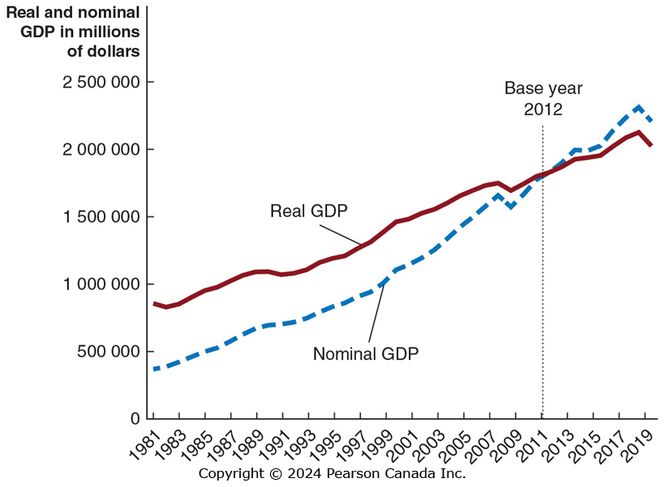
Figure 4.4 Nominal GDP and Real GDP
The current base year for calculating prices is 2012, so real and nominal GDP are equal in 2012.
Growth figures reported in the media are the growth in real GDP.
Since prices have generally increased since 2012, real GDP is less than nominal GDP, and the opposite is true before 2012.
SOURCE: Statistics Canada, “Gross Domestic Product, Expenditure Based, Provincial and Territorial, Annual (×1,000,000),” Table 36-10.0222-01.

Slide 37
The GDP Deflator
Economists and policy-makers are interested in the price level: a measure of the average prices of goods and services in the economy.
Stable prices are desirable because they allow households and firms to plan for the future appropriately.
In order to know whether we are achieving price stability, we need to measure the price level.
One way to do this is using the GDP deflator: a measure of the price level, calculated by dividing nominal GDP by real GDP and multiplying by 100:
Since nominal and real GDP will be the same in the base year, the GDP deflator will be 100 in the base year.

Slide 38
Calculating the GDP Deflator
 | 2019 | 2020
Nominal GDP | $2311 billion | $2206 billion
Real GDP | $2125 billion | $2023 billion
Formula | Applied to 2019 | Applied to 2020
The GDP deflator increased from 108.8 to 109.0 between the two years. This is a 0.2% increase:
So we say the price level rose 0.2% between 2019 and 2020.

Slide 39
Conclusion
GDP measures the size of an economy – either total income or total expenditure.
GDP measures economic activity that takes place in markets. It excludes some important things.
GDP is not intended to be a measure of well being, but well being and GDP are related.
Real GDP controls for inflation, nominal GDP does not. The GDP Deflator is a measure of the price level.
There are also other measures of total production and total income.

